Slide 1
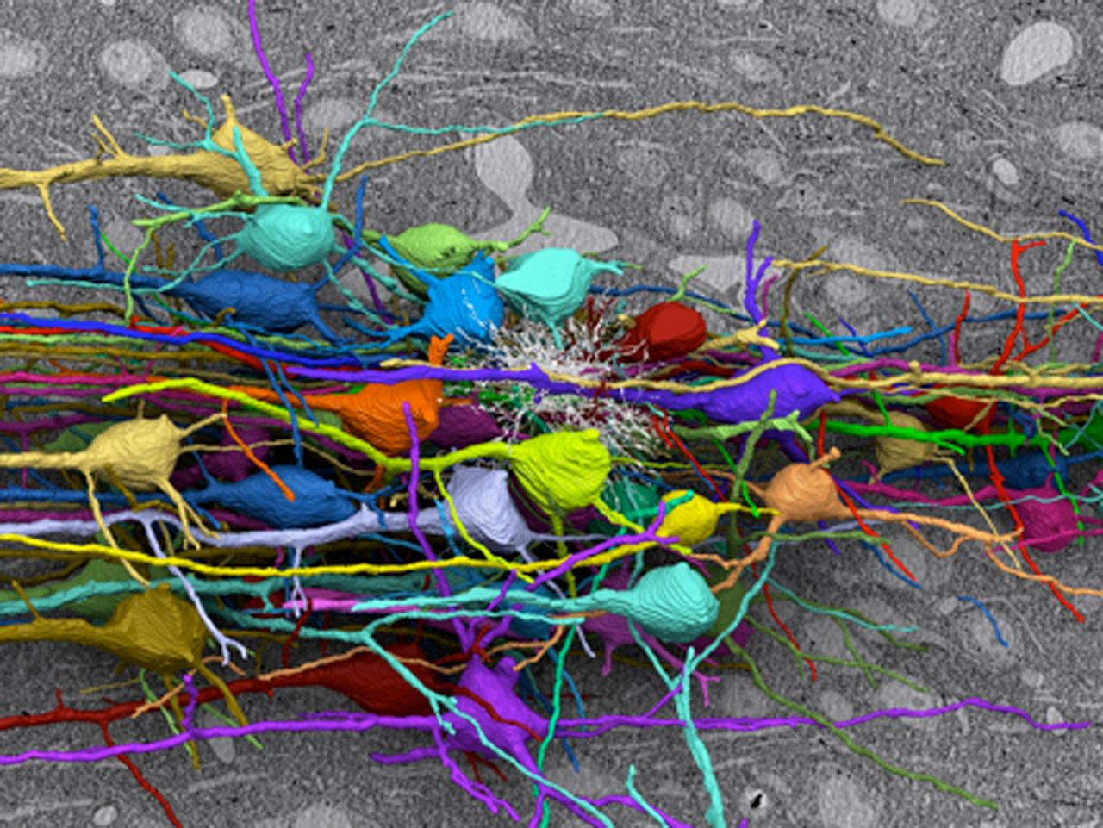
The mind’s tangled web: Electron microscope reconstruction of mouse brain cortex.
Nair P PNAS 2013;110:5739
©2013 by National Academy of Sciences
Notes:
The mind’s tangled web: Electron microscope reconstruction of mouse brain cortex. Image courtesy of D. Berger, N. Kasthuri, H. S. Seung, and J. W. Lichtman (Harvard University and Massachusetts Institute of Technology).

